Slide 1
Adaptive Recreation “…enjoy life” -Cindy Jacobelli MEd Director of Adaptive Recreation at Cardinal Hill

Slide 2
Learning Objectives
Gain an understanding of why adaptive recreation is such an important aspect of a person’s life.
To learn about different adaptive recreation activities and equipment available for people with disabilities.
To provide a hands-on experience with various types of adaptive equipment.

Slide 3
Adaptive Recreation
provides an opportunity to participate in activities that challenge peoples expectations and misconceptions.
is a MAJOR contributor to feelings of health, wellness and higher quality of life…
Through the use of activity modifications and assistive technology, people are able to participate alongside their non-disabled peers

Slide 4
Adaptive Equipment
Machines or equipment used to level the playing field in competition, and to allow someone the opportunity to participate, that could not do so without its benefit.

Slide 5
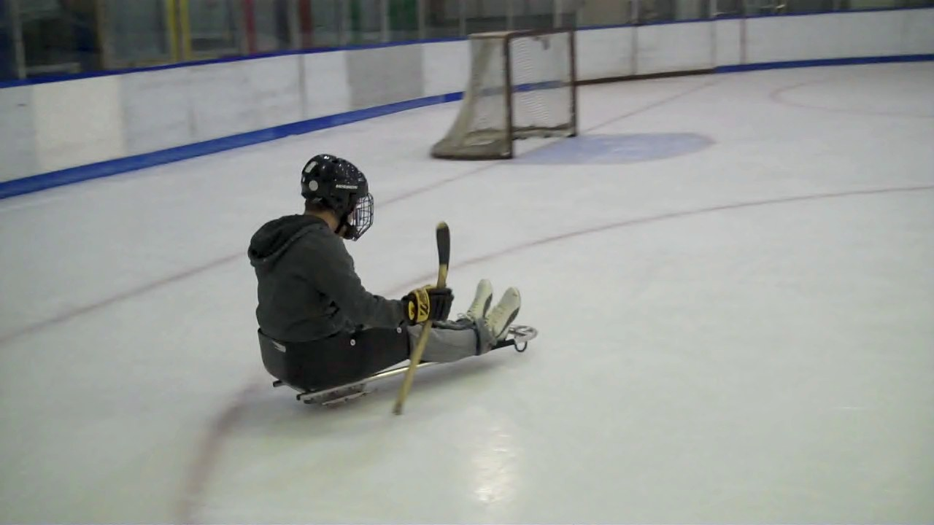
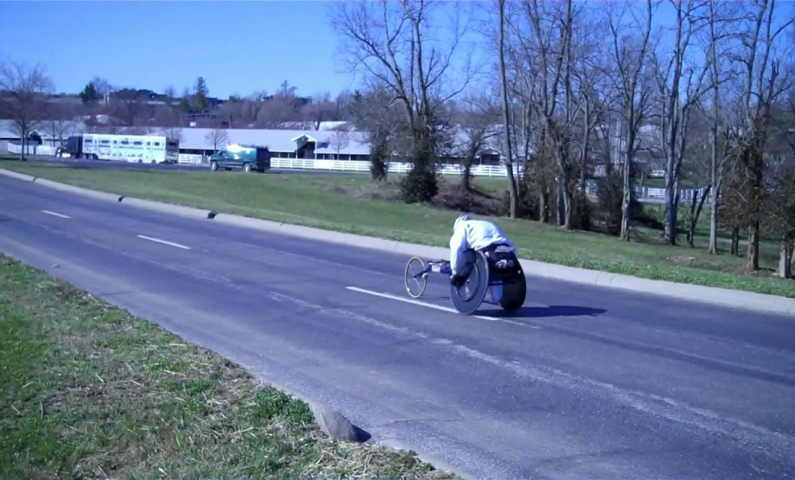
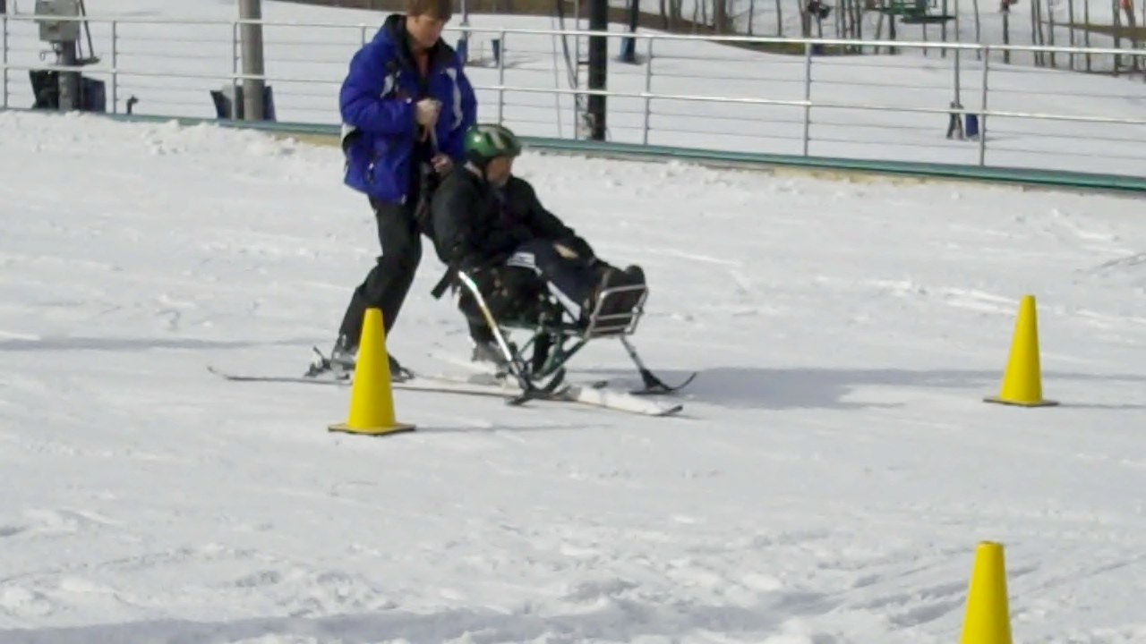
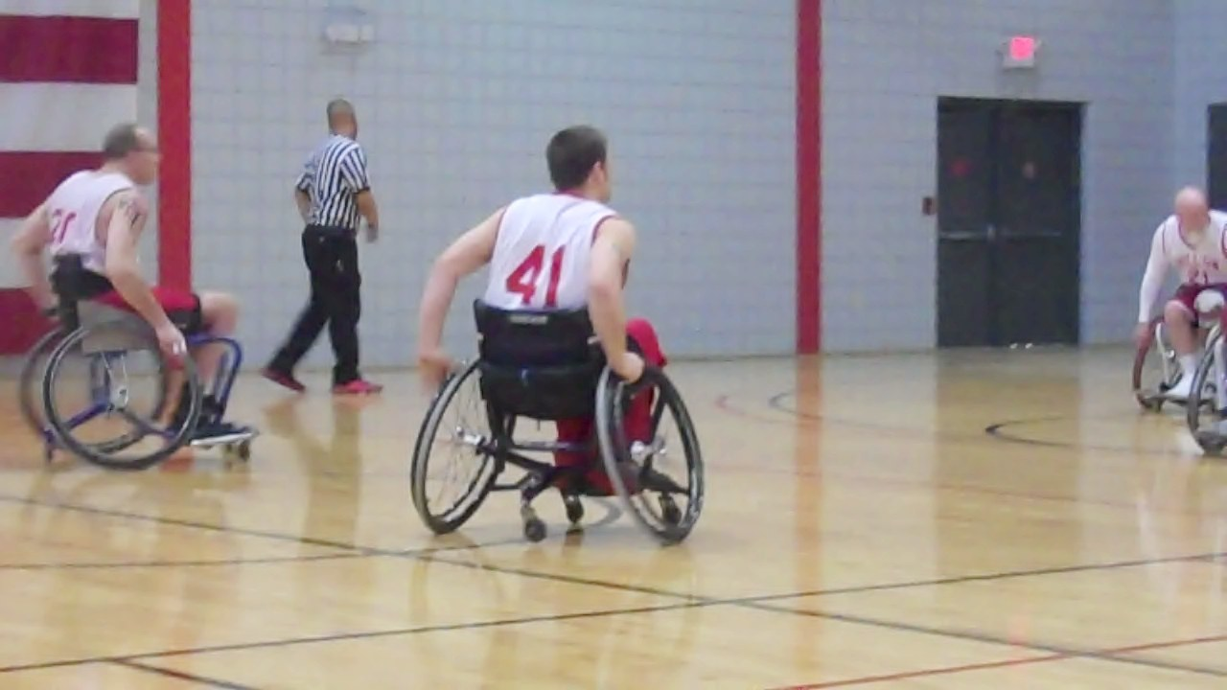

Slide 6
Why is participation in adaptive recreation so important?

Slide 7
The concerns…
More than HALF of people with disabilities do not engage in ANY physical activity
•People with disabilities feel LESS satisfied with their quality of life than individuals without disabilities.

Slide 8
The GOOD NEWS…
There are many options available for people with disabilities to participate in adaptive recreation right here in our area…

Slide 9
Benefits of Adaptive Recreation
Stress Reduction
Social Interactions
Physical Fitness
Skill Development
Improved Self-Esteem
Strengthen Interpersonal Skills
Improve Overall Well Being

Slide 10
Types of adaptive recreation activities and equipment

Slide 11
High Risk and High Adventure
White Water Rafting
Sky Diving
Mountain Climbing
Wilderness Trips
SCUBA Diving
These activities are designed to increase self-confidence and self-esteem, independent functioning, strength and endurance. Cater towards the “adrenaline junkie”.

Slide 12
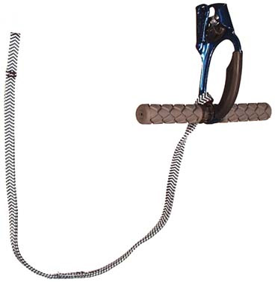
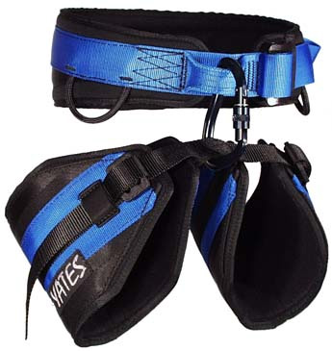
Rock Wall

Slide 13
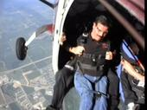
Sky Diving

Slide 14
Active
Basketball
Softball
Rugby
Gardening
Skiing (snow and water)
Traveling
Hunting/ Archery
Weight lifting
Horseback Riding/Driving
Billiards
Swimming
Cycling
Golf
Tennis
Kayaking
Bowling
These activities increase strength, endurance, motor functioning, self-confidence, and help reduce stress. They also satisfy ones need for competition.

Slide 15
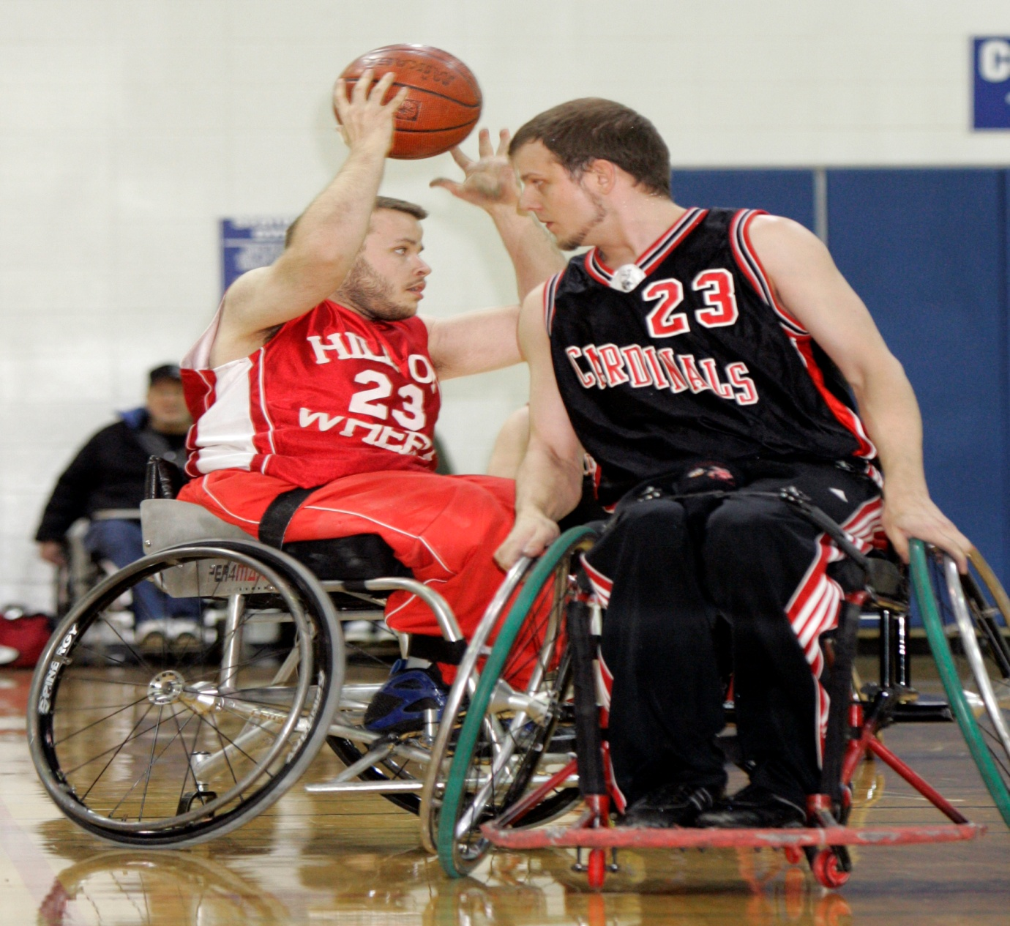
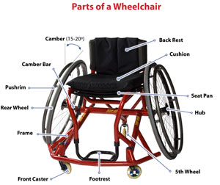
Wheelchair Basketball Cardinal Hill Rehabilitation Hospital’s Basketball team Hill on Wheels

Slide 16
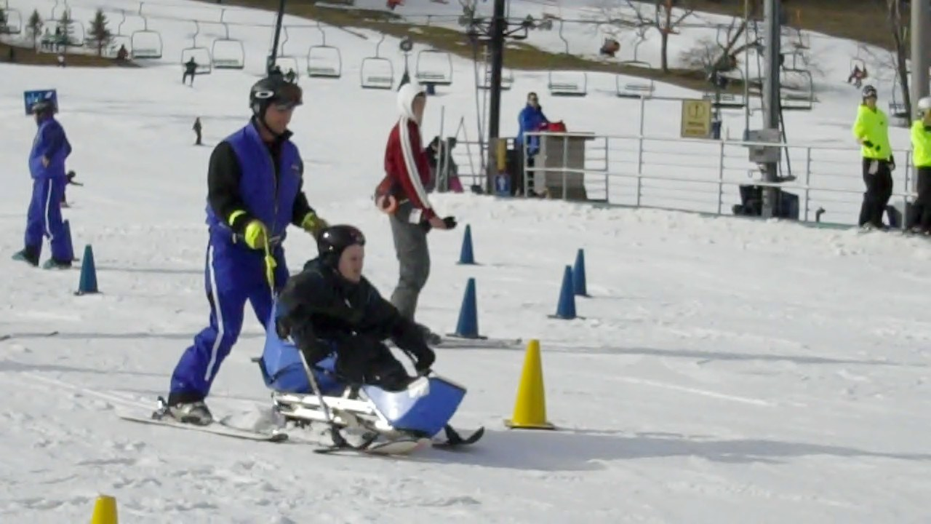
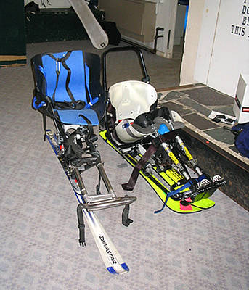
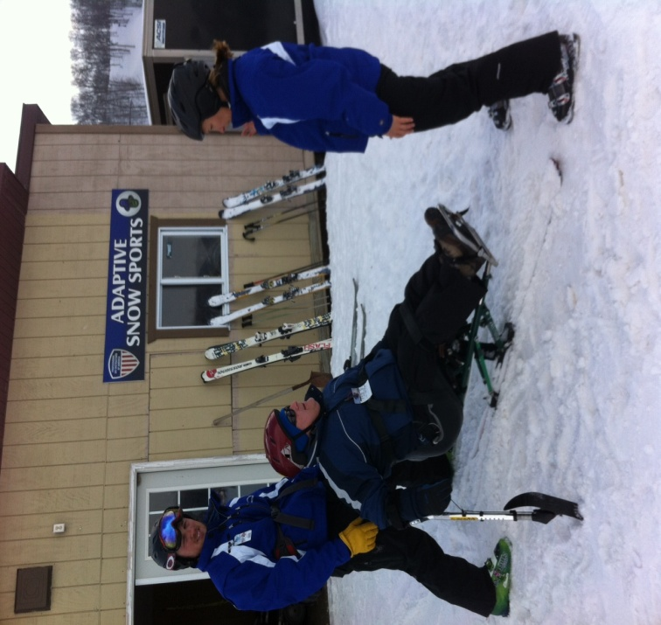
Adaptive Skiing Former patients at Perfect North

Slide 17
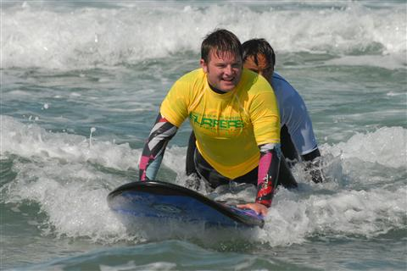
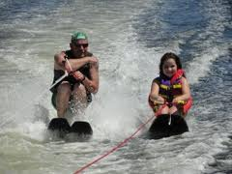
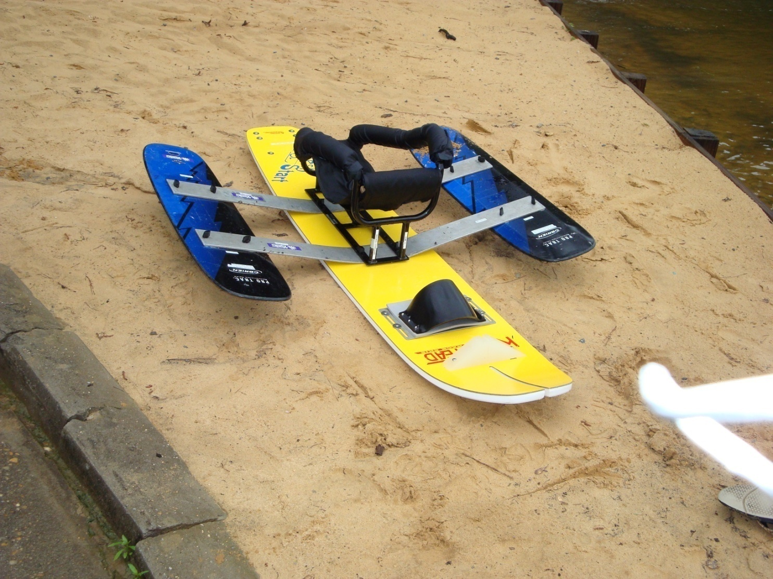
Adaptive Water Skiing/ Surfing

Slide 18
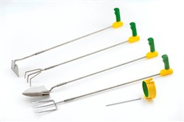
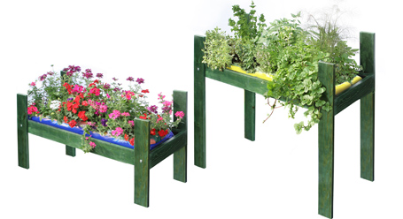
Therapeutic Gardening Cardinal Hill Garden

Slide 19
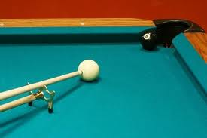
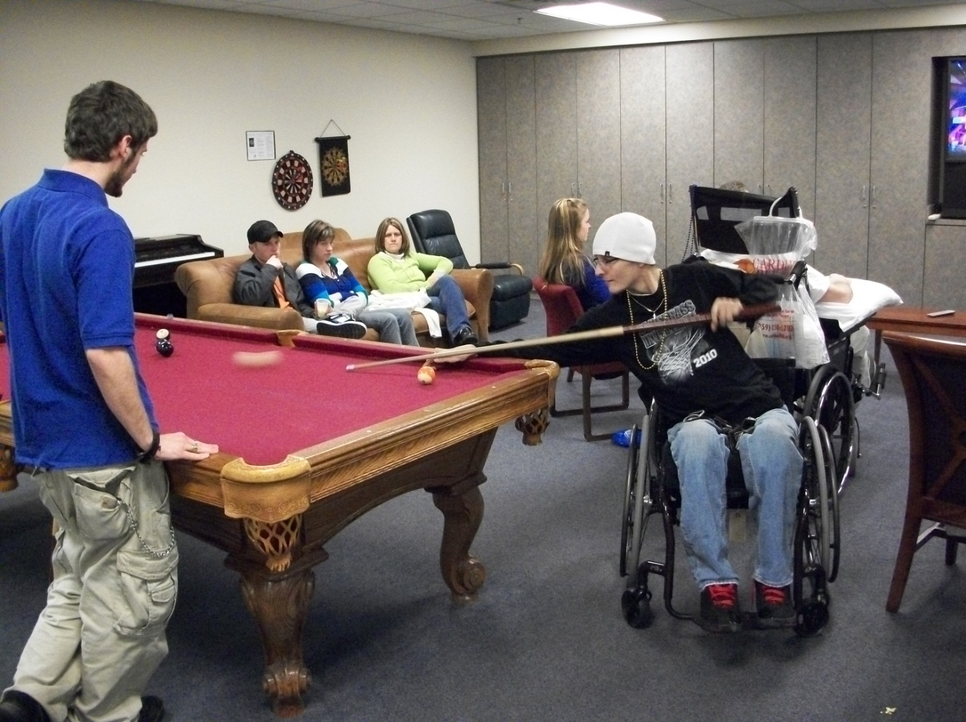
Billiards

Slide 20
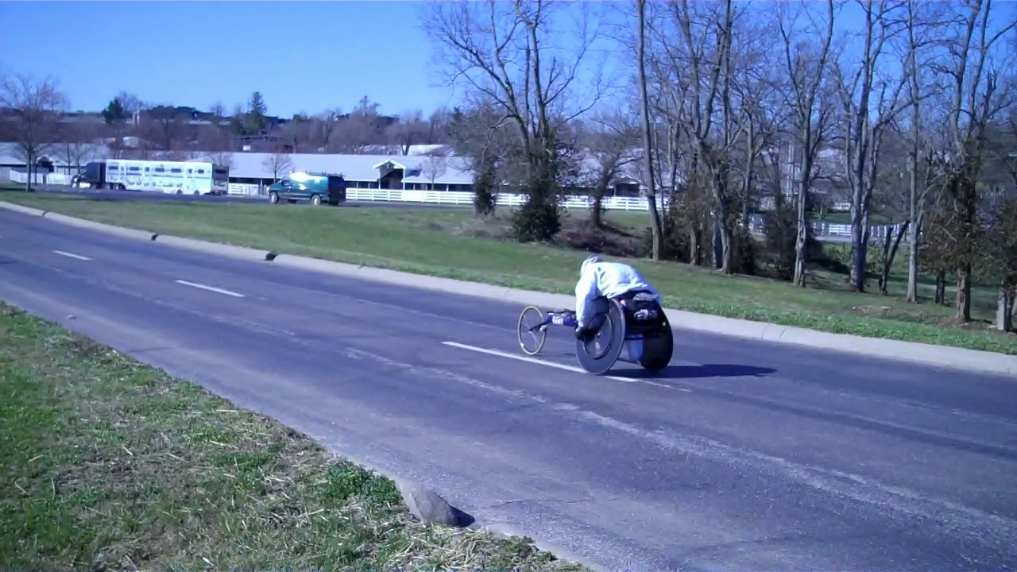
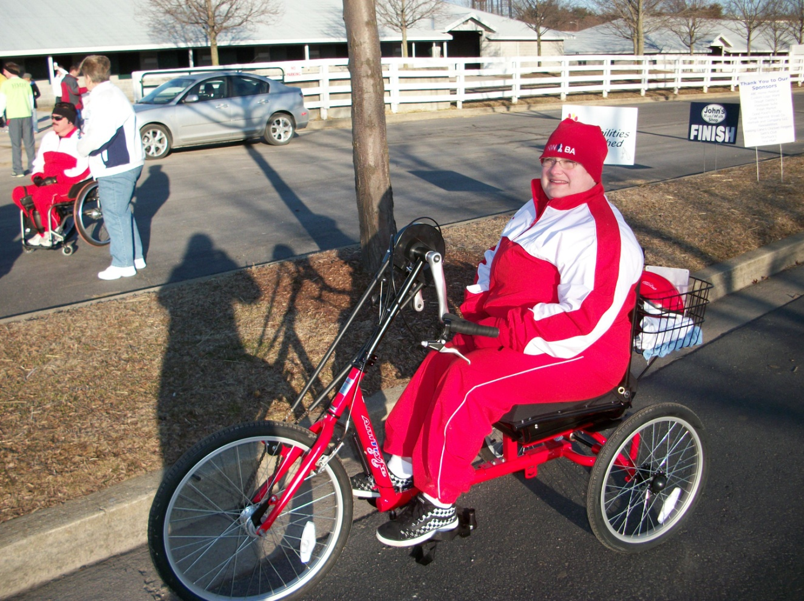
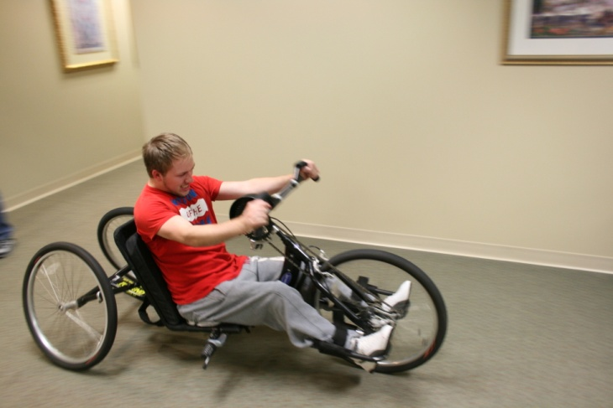
Hand Cycle Run for the Hill 5k at Keeneland

Slide 21
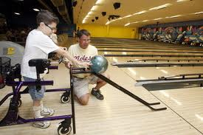
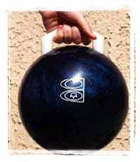
Bowling

Slide 22
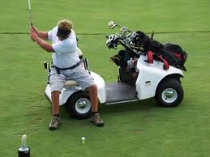
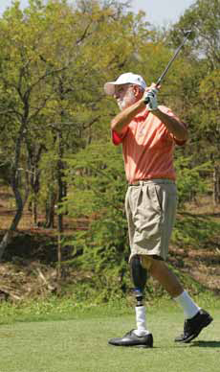
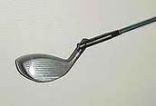
Adaptive Golf

Slide 23
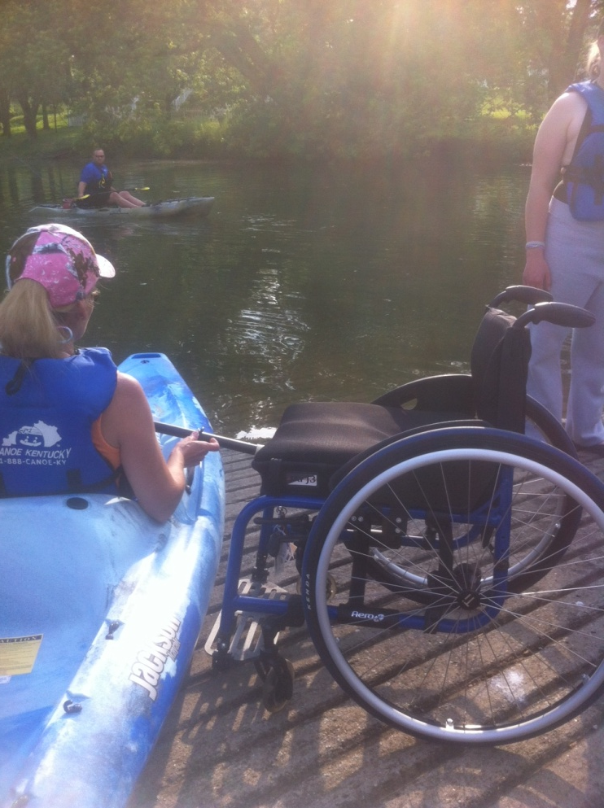
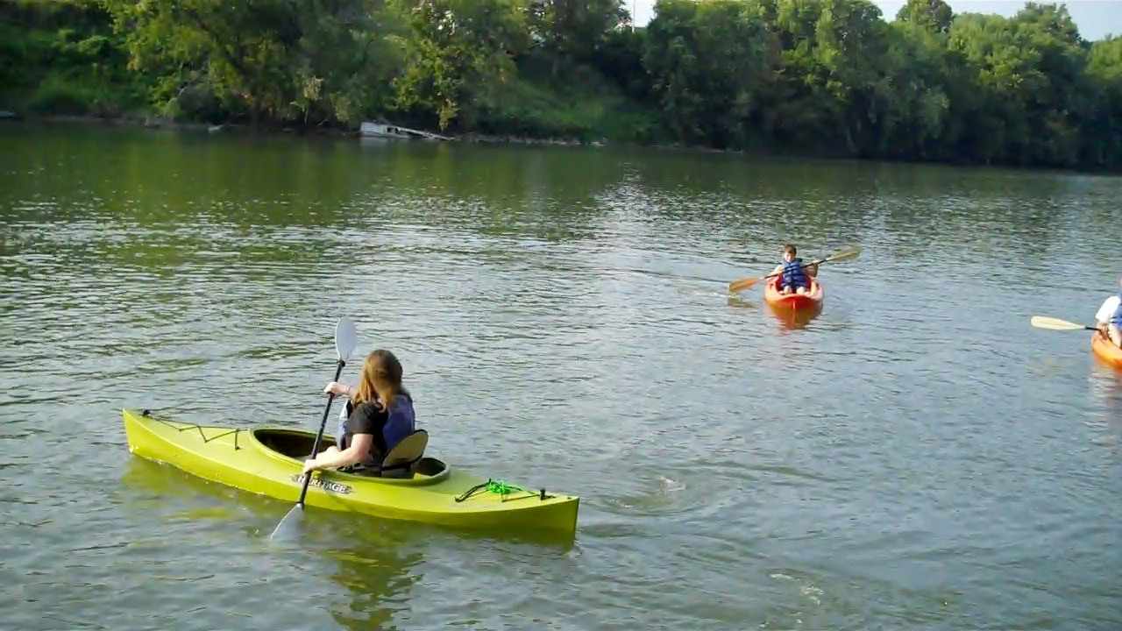
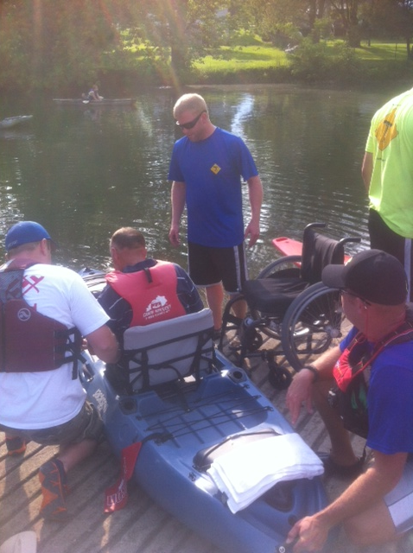
Kayaking Canoe Kentucky

Slide 24
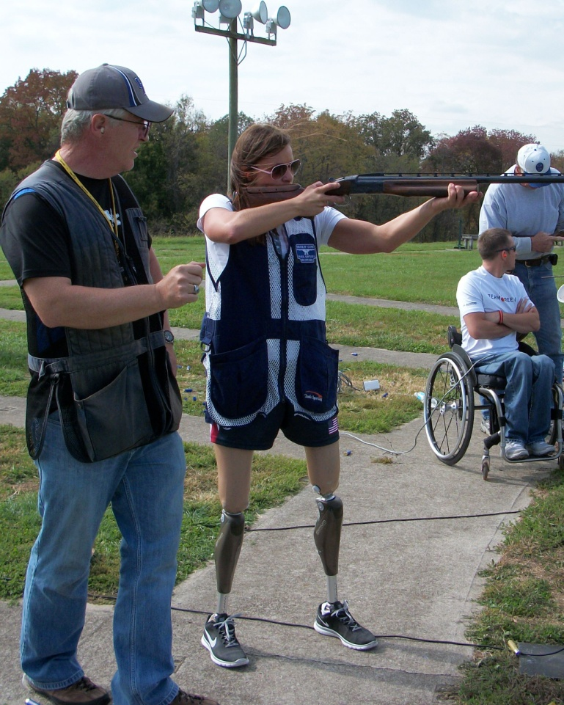
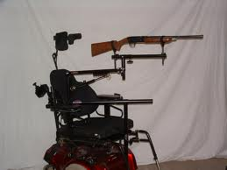
Shooting Sports at the Blue Grass Sportsmen’s League in Wilmore KY

Slide 25
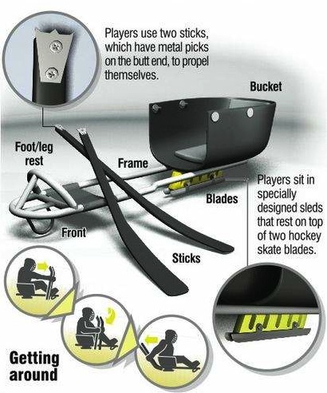
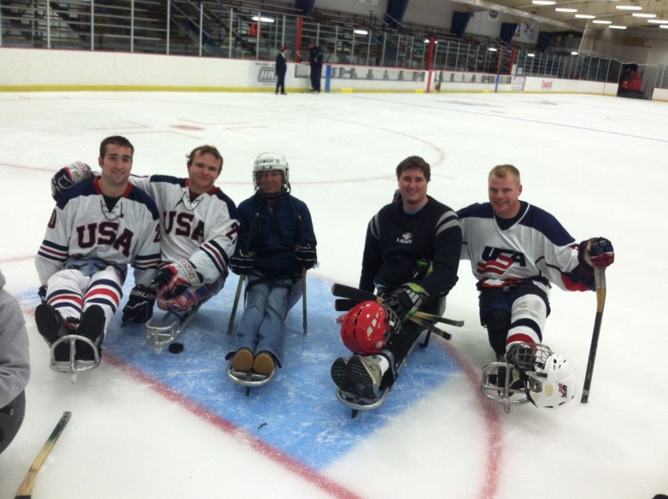
Sled Hockey Lexington Ice Center

Slide 26
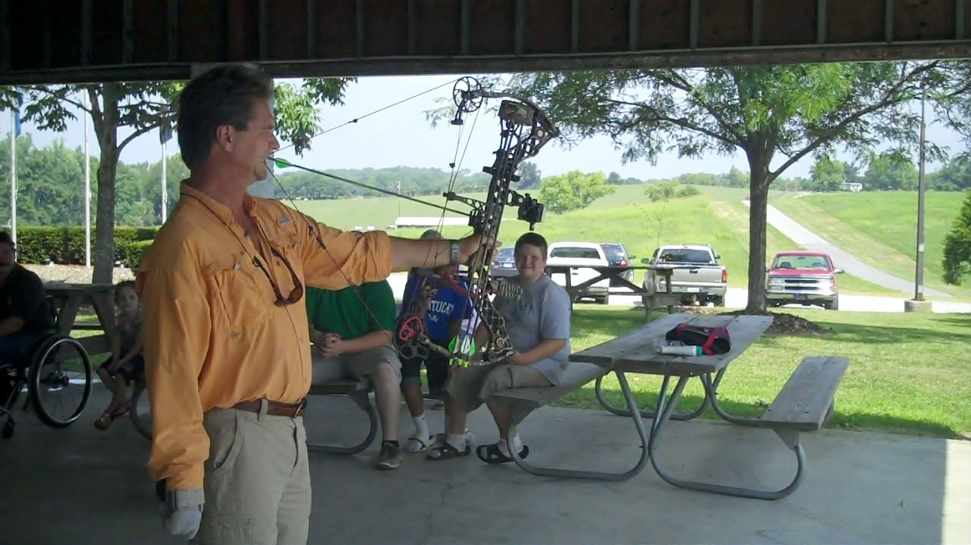
Archery

Slide 27
Wheelchair Tennis

Slide 28
Leisure
Camping
Cooking
Dancing
Going to the beach
Shopping
Fishing
Church activities
Singing or playing instruments
Attending movies, concerts
Dining out
Volunteering
These activities increase endurance, fine motor functioning, self-confidence and help reduce stress. They also increase social contacts in a non-competitive setting.

Slide 29
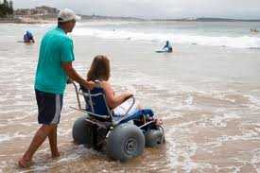
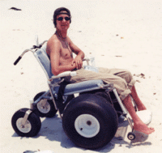
Going to the Beach

Slide 30
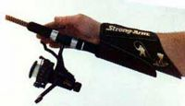
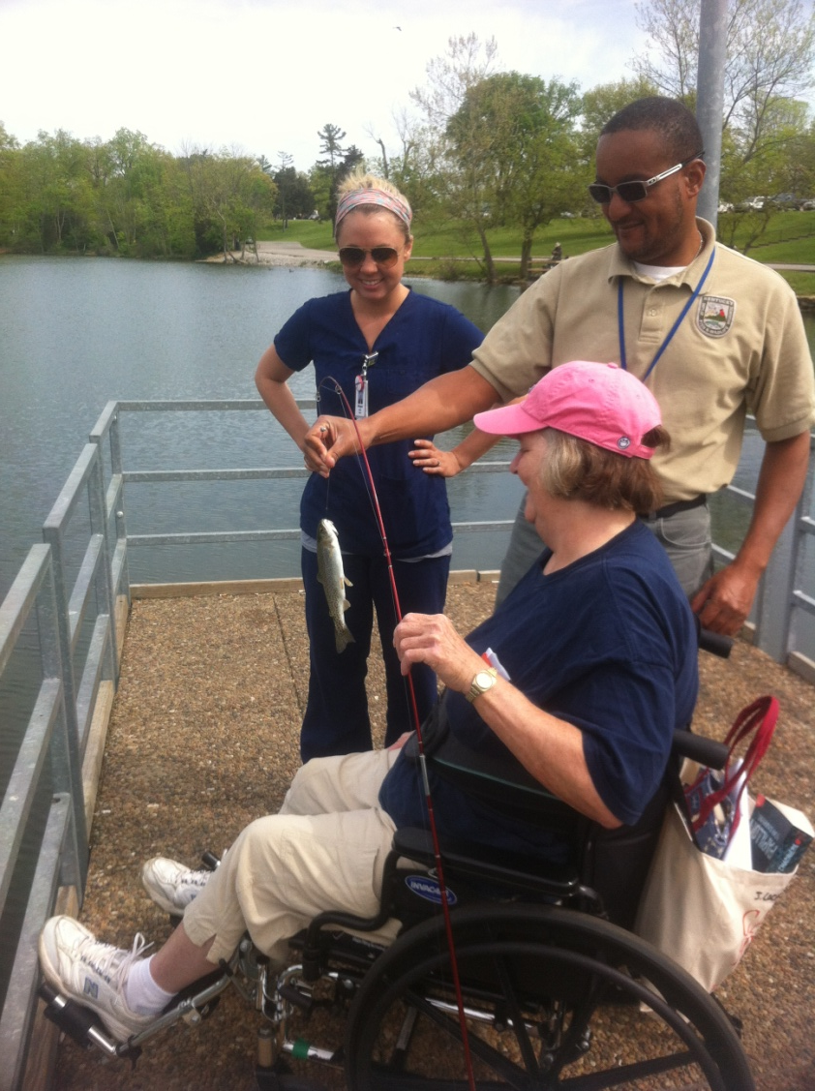
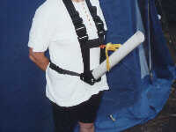
Fishing

Slide 31
Passive
Reading
Table games
Playing Cards
Crafts
Painting
Computer and Video Games
Watching TV
Writing
These activities help reduce stress and increase fine motor functioning.

Slide 32
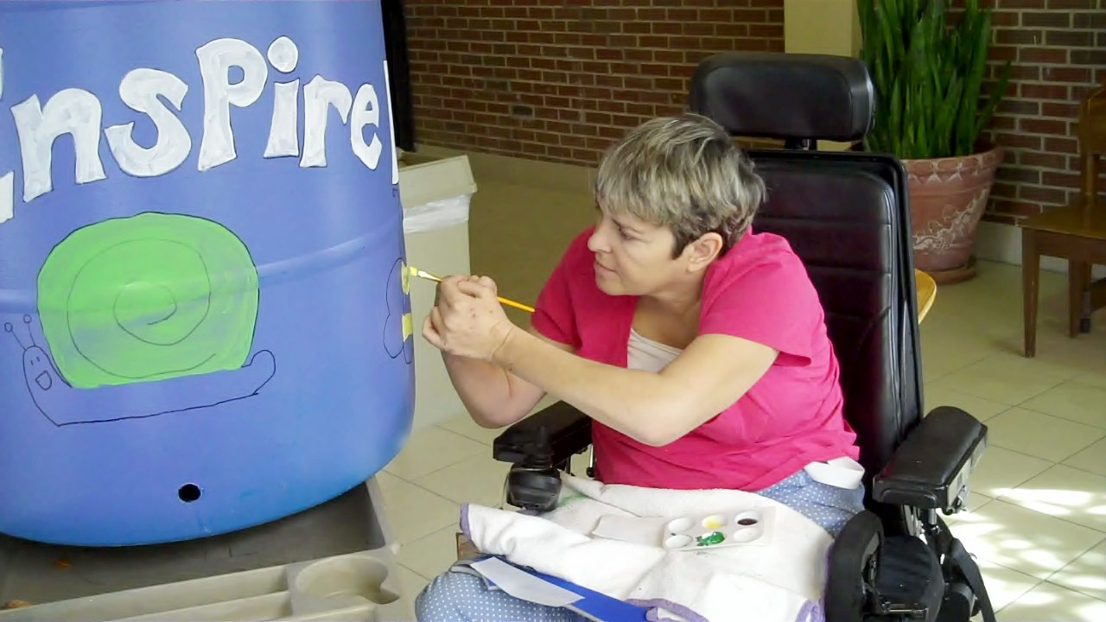
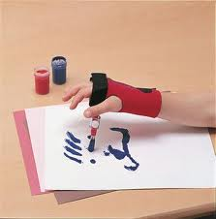
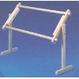

Slide 33
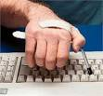
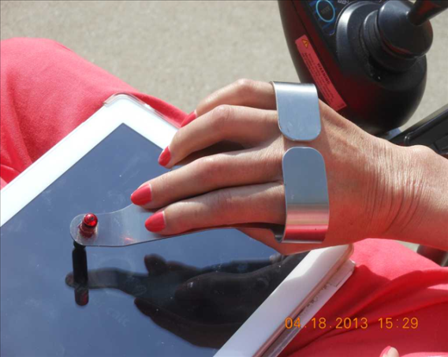
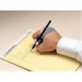

Slide 34
Adaptive Recreation at Cardinal Hill PROGRAM PHILOSOPHY
To encourage persons with physical disabilities to participate in Adaptive Recreation.
To offer various opportunities to participate to all individuals with physical disabilities.
To promote the growth of Adaptive Recreation in the city of Lexington and the surrounding Bluegrass area.
To promote a feeling of teamwork, sportsmanship, competition and discipline.
To respect each other and recognize individual strengths and accept their weaknesses.
To be an ambassador of Adaptive Recreation.

Slide 36
Risk Factors
ALWAYS talk to your doctor, nurse specialist and therapists before participating in activities.
ALWAYS protect your skin with sunscreen no matter what activity you are participating in
ALWAYS remember that your cushion gets very hot in the sun. Cover it if you are out of your chair for any amount of time.
ALWAYS use your cushion when you are participating in activities
ALWAYS bring all necessary personal care items for emergencies

Slide 37
References
www.spineywhitetripod.com
Physical Activity and Sport for People with Disabilities: Symposium and Strategic Planning
www.ncapd.com
www.com.wikipeida.com
Christopher and Dana Reeve Paralysis Resource Guide
Lanig, IS. Ed. A Practical Guide to Health and Promotion After Spinal Cord Injury. Gaithersburg, MD: Aspen Publishers, Inc. 1996
Hall, E. (Spring 2005). Living well! The benefits of leisure for people with disabilities. Bloomington, IN: National Center on Accessibility, Indiana University-Bloomington

Slide 38
LETS GO PLAY!

